Slide 1
3.1 Multiway Search Tree
BTree

Slide 2
Multiway Search Tree
Generalised versions of binary trees where each node contains multiple elements
A Multiway Search Tree of order n is a general tree in which
each node has n or fewer subtrees and
contains no of keys as one less than no of subtrees
i.e. In an m-Way tree of order n,
each node contains a maximum of n – 1 elements and n children.
If the Node has 4 subtrees, it contains 3 keys

Slide 3
Multiway Search Tree
The goal of m-Way search tree of height h calls for O(h) no. of accesses for an insert/delete/retrieval operation.

Slide 4
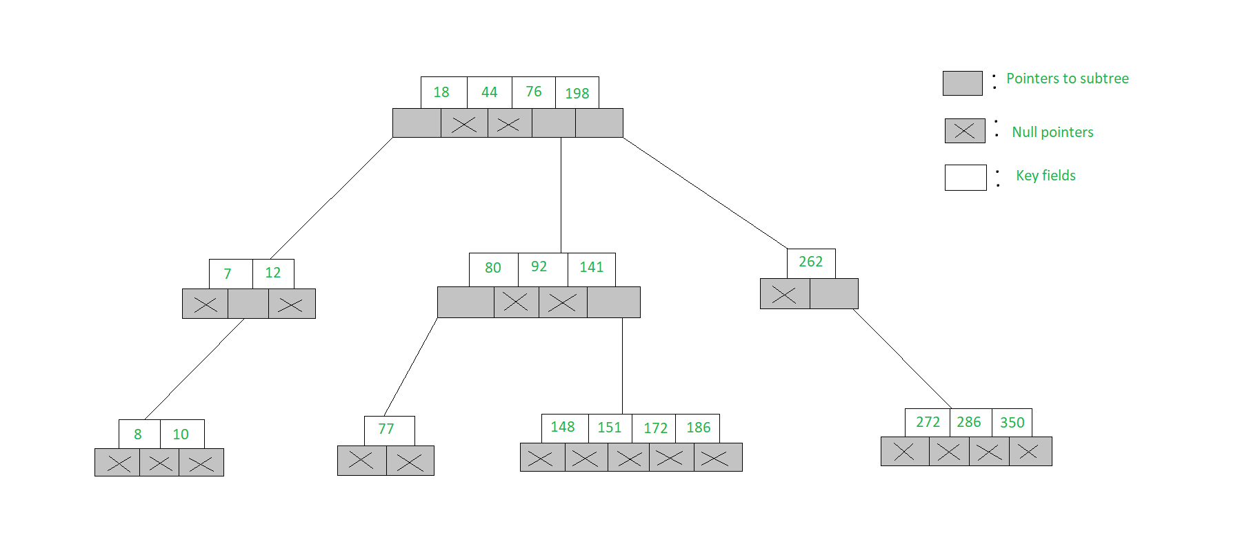
Multiway Search Tree
5-Way search tree
Each node has at most 5 child nodes and at most 4 keys

Slide 5
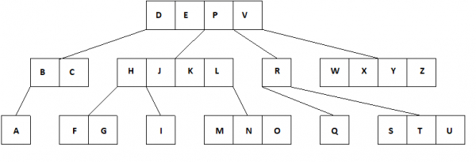
Multiway Search Tree
5-Way search tree
Multiway tree of order 5
Each node has at most 5 child nodes and at most 4 keys

Slide 6
Multiway Search Tree
Structure of a node of an m-Way tree
struct node {
int count;
int value[MAX];
struct node* child[MAX + 1];
};
count represents the number of children that a particular node has
The values of a node stored in the array value
The addresses of child nodes are stored in the child array
The MAX macro signifies the maximum number of values that a particular node can contain

Slide 7
Structure of M-Way Search Tree Node
P0, P1 …, Pn are the pointers to the node’s sub-trees
K0, k1, …, Kn-1 are the key values of the node.
All the key values are stored in ascending order.
The basic properties of M-way search trees:
Key vales in the sub tree pointed by P0 < key value K0.
Key values in the sub-tree pointed by P1 > key value K0
Similar pattern for the rest of the P’s and K’s.

Slide 8
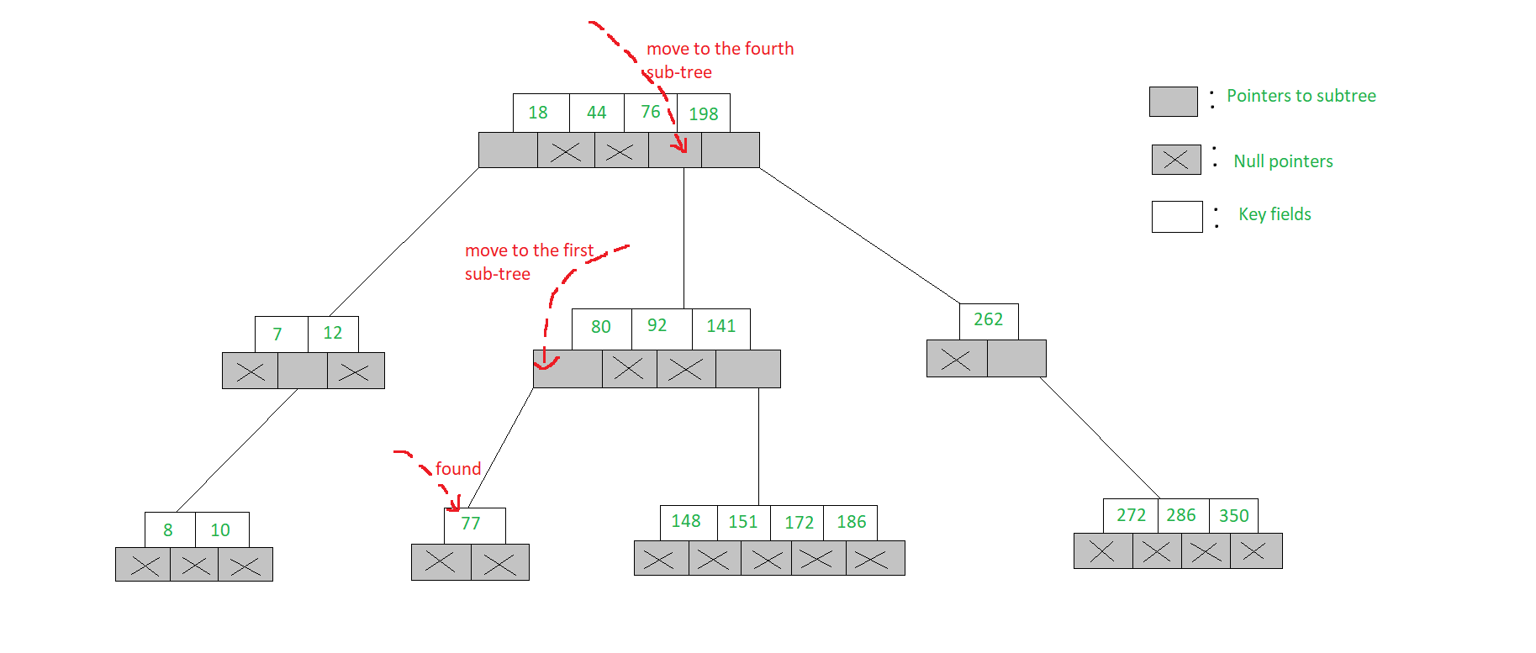
Searching in an m-Way search tree
Similar to that of binary search tree
To search for 77 in the 5-Way search tree,
Begin at the root
As 77> 76> 44> 18, move to the fourth sub-tree
In the root node of the fourth sub-tree, 77< 80 & therefore we move to the first sub-tree of the node.
Since 77 is available in the only node of this sub-tree

Slide 9
B Tree

Slide 10
B Tree
A balanced order n multiway search tree in which each non-root node contains atleast (n-1)/2 keys is called B Tree of Order n
B Tree of O(n)
Max no of keys in each node (root/non-root)=n-1
Min no of keys in each non-root node=(n-1)/2

Slide 11
Properties of B Tree
All leaf nodes will be at same level
Every node except root must contain at least ([n-1]/2) keys. The root may contain minimum 1 key.
All nodes (including root) may contain at most n – 1 keys.
Number of children of a node is equal to the number of keys in it plus 1.

Slide 12
Properties of B Tree
All keys of a node are sorted in increasing order.
The child between two keys k1 and k2 contains all keys in the range from k1 and k2.
B-Tree grows and shrinks from the root which is unlike Binary Search Tree. Binary Search Trees grow downward and also shrink from downward.

Slide 13
Properties of B Tree
The B stands for balanced,
In a B-tree the left and right side of each node is roughly kept to the same size (number of subnodes)

Slide 14
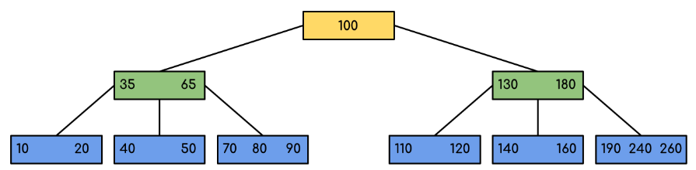
Example
B-Tree of minimum order 5.
All the leaf nodes are at the same level

Slide 15
Animation for Searching in B Tree
https://condor.depaul.edu/ichu/csc383/notes/notes7/B-Trees_files/tree-search.gif
Courtesy: https://condor.depaul.edu/ichu/csc383/notes/notes7/btree.html

Slide 16
Searching in B Tree
Searching in B Trees is similar to that in Binary search tree.
Let the key to be searched be k.
Start from the root
Recursively traverse down.
For every visited non-leaf node, if the node has the key, we simply return the node.
Otherwise, we recur down to the appropriate child (The child which is just before the first greater key) of the node.
If we reach a leaf node and don’t find k in the leaf node, we return NULL.

Slide 17
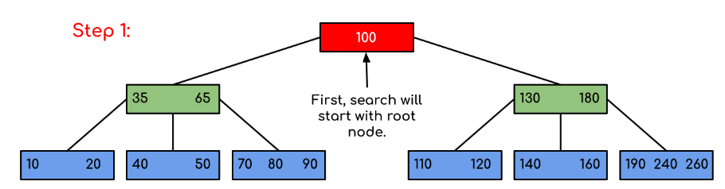
Searching in B Tree
Search for 120

Slide 18
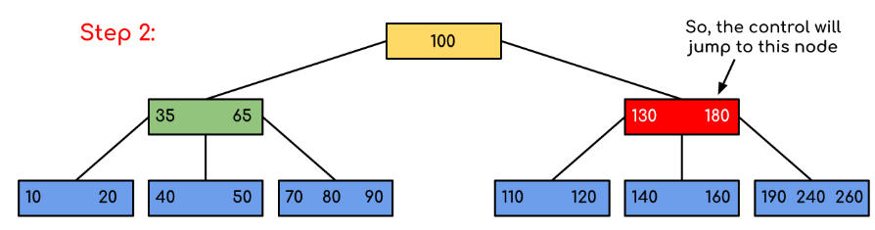

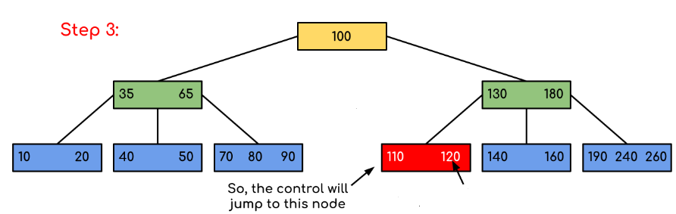
Searching in B Tree

Slide 19
Insertion in B Tree

Slide 20
Insertion in B Tree
Insertion requires first traversal in B Tree
Check key to be inserted is already existing or not, through traversal
Suppose the key does not exist in tree then through traversal , it will reach the leaf node
We will have 2 cases for inserting the keys

Slide 21
Insertion in B Tree
The 2 cases are-
Case 1: Node is Not Full
Case 2: Node is already full

Slide 22
Insertion in B Tree
Case 1: Node is Not Full-
We simply add the key in the Node
Case 2: Node is already full-
Split the Node in 2 nodes
Median key goes to the parent of that node
If parent is also full then same process will be repeated until it will get non-full parent node

Slide 23
Algorithm for Insertion in B Tree
The following algorithm applies:
Run the search operation and find the appropriate place of insertion.
Insert the new key at the proper location, but if the node has a maximum number of keys already:
The node, along with a newly inserted key, will split from the middle element.
The middle element will become the parent for the other two child nodes.
The nodes must re-arrange keys in ascending order.
Courtesy-https://www.guru99.com/b-tree-example.html

Slide 24
Algorithm for Insertion in B Tree
TIP
The following is not true about the insertion algorithm:
Since the node is full, therefore it will split, and then a new value will be inserted
CORRECT METHOD-
The node, along with a newly inserted key, will split from the middle element.
Courtesy-https://www.guru99.com/b-tree-example.html

Slide 25
Insertion with Odd Order

Slide 26
Insertion in B Tree
Create a B Tree of Order 5
n=5
List of Keys=10,70,60,20,110,40,80,130,100,50,190,90,180,240,30,120,140,160
Max no of keys in each node (root/non-root)=n-1=4
Min no of keys in each non-root node=(n-1)/2=2

Slide 27



Insertion in B Tree
List of Keys=10,70,60,20,110,40,80,130,100,50,190,90,180,240,30,120,140,160
Insert 10
Insert 70
After Inserting 70, the keys in the node will be sorted
Insert 60
After Inserting 60, the keys in the node will be sorted

Slide 28

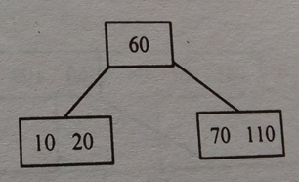
Insertion in B Tree
List of Keys=10,70,60,20,110,40,80,130,100,50,190,90,180,240,30,120,140,160
Insert 20
After Inserting 20, the keys in the node will be sorted
Insert 110
Node was already full,
After insertion of 110 , It splits into 2 nodes
60 is the median key, so it goes to parent or becomes root

Slide 29
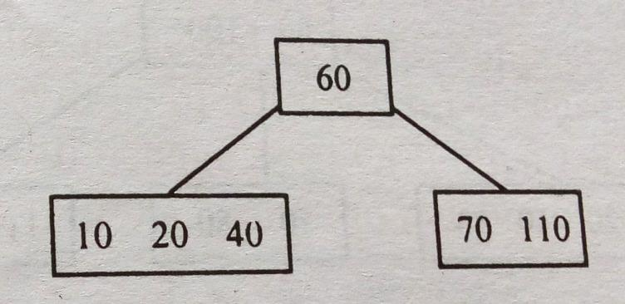
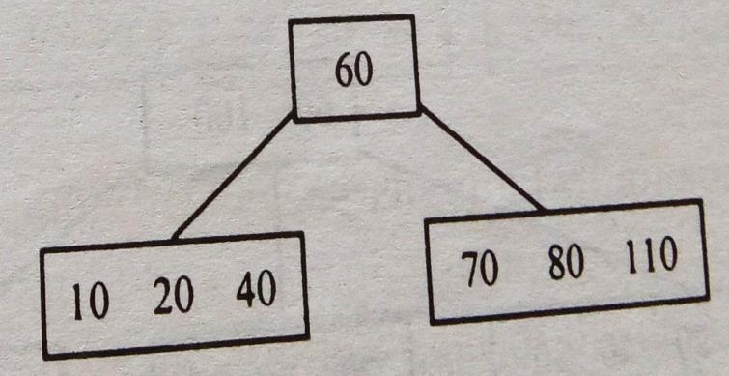
Insertion in B Tree
List of Keys=10,70,60,20,110,40,80,130,100,50,190,90,180,240,30,120,140,160
Insert 40
After Inserting 40, the keys in the node will be sorted
Insert 80
After Inserting 80, the keys in the node will be sorted

Slide 30
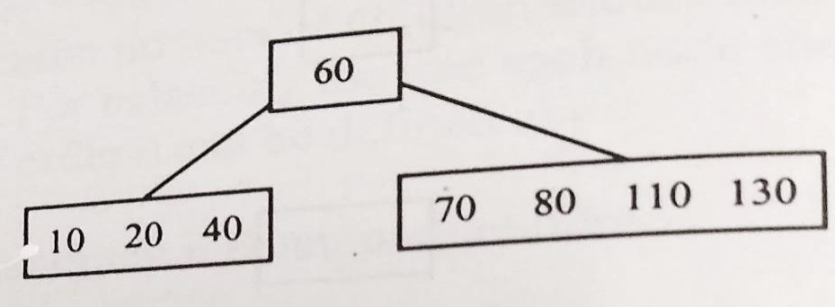
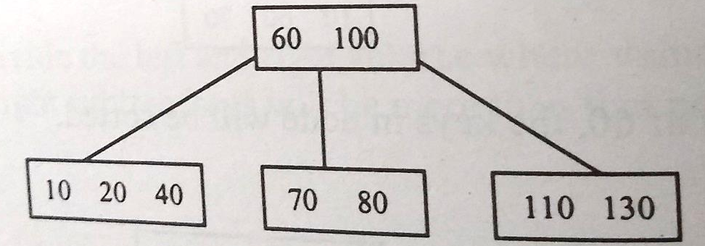
Insertion in B Tree
List of Keys=10,70,60,20,110,40,80,130,100,50,190,90,180,240,30,120,140,160
Insert 130
Insert 100
Node was already full
After insertion of 100, it splits in 2 nodes, 100 is the median key ,
100 goes up to the parent node

Slide 31
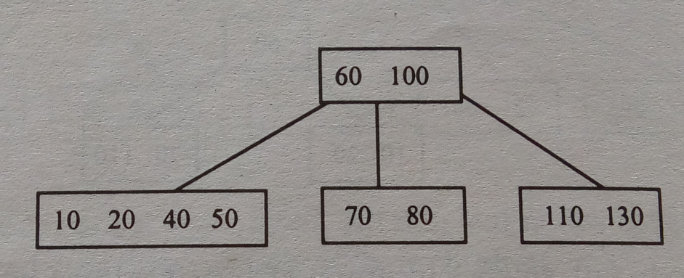
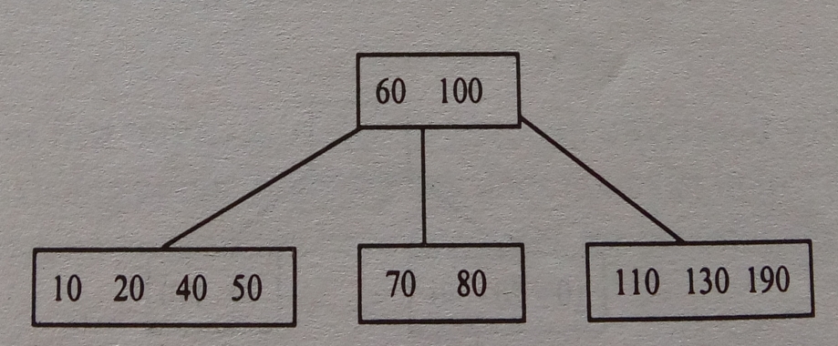
Insertion in B Tree
List of Keys=10,70,60,20,110,40,80,130,100,50,190,90,180,240,30,120,140,160
Insert 50
Insert 190

Slide 32
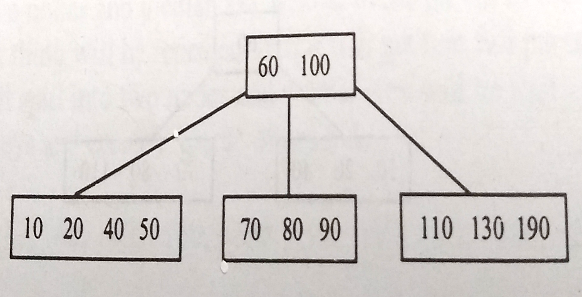
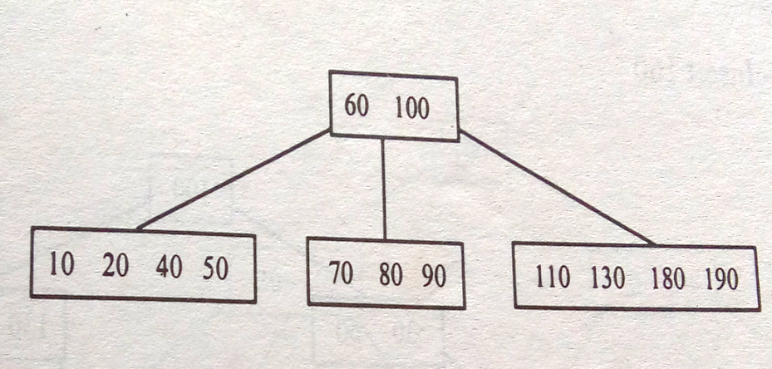
Insertion in B Tree
List of Keys=10,70,60,20,110,40,80,130,100,50,190,90,180,240,30,120,140,160
Insert 90
Insert 180

Slide 33
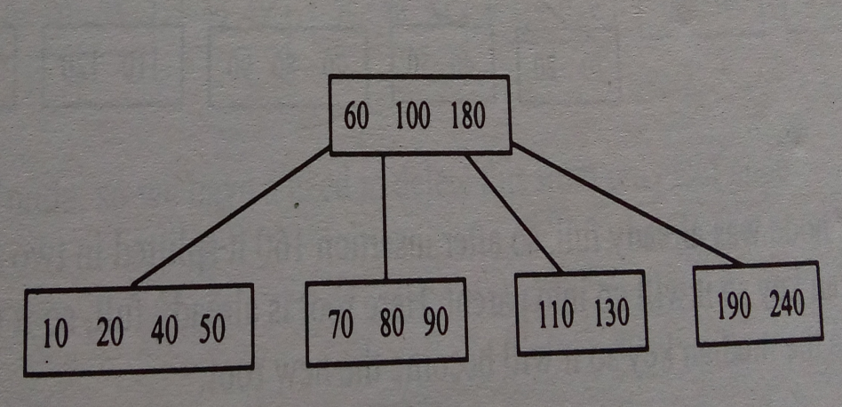
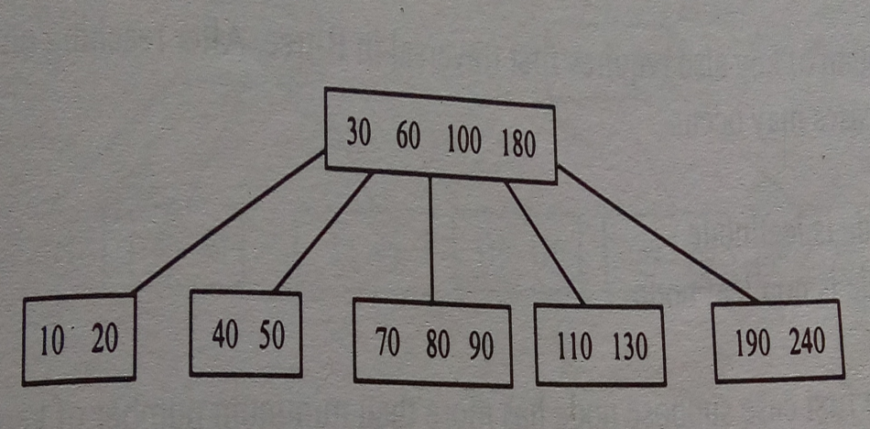
Insertion in B Tree
List of Keys=10,70,60,20,110,40,80,130,100,50,190,90,180,240,30,120,140,160
Insert 240
Insert 30
Node was already full, so after insertion of 30, splits in 2 nodes, 30 is the median key so it will go to the parent

Slide 34
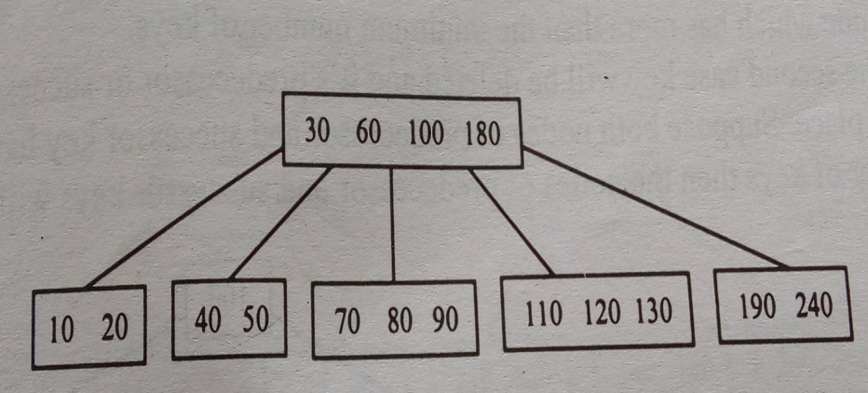
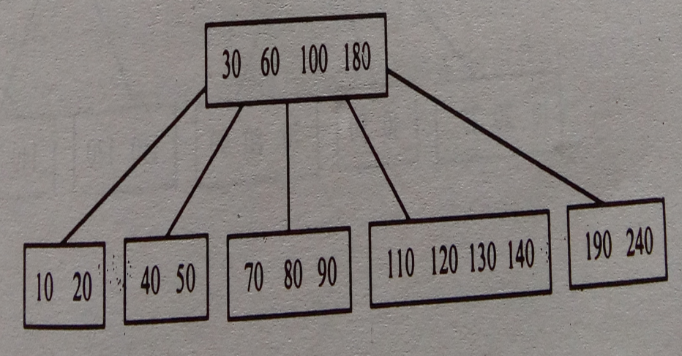
Insertion in B Tree
List of Keys=10,70,60,20,110,40,80,130,100,50,190,90,180,240,30,120,140,160
Insert 120
Insert 140

Slide 35
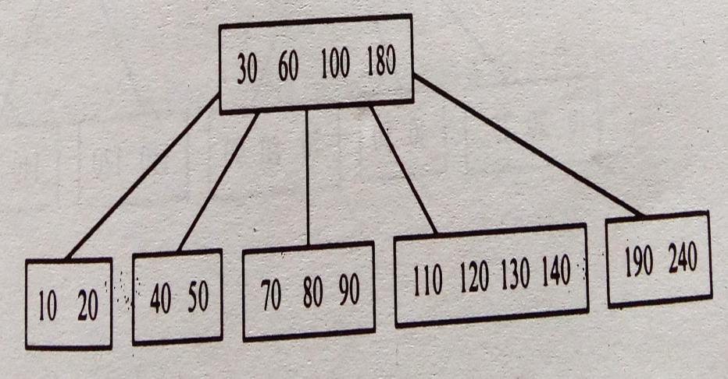
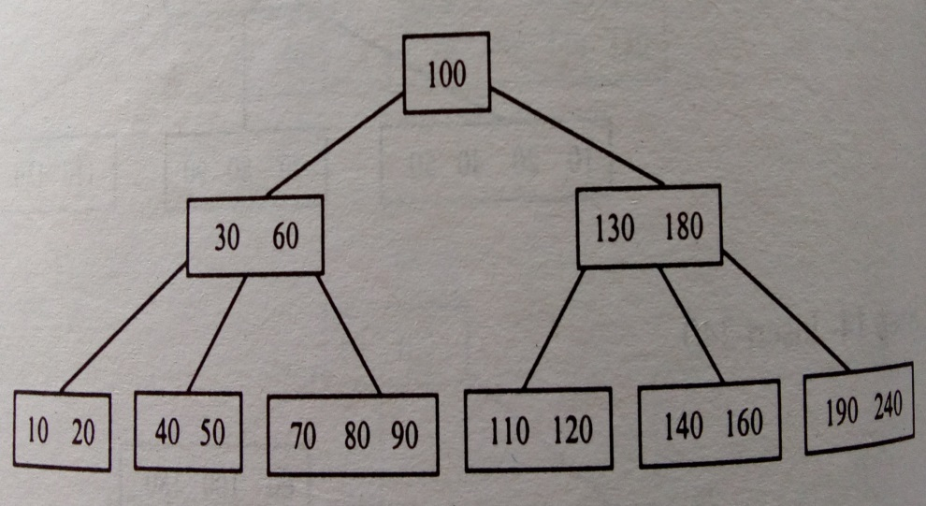
Insertion in B Tree
List of Keys=10,70,60,20,110,40,80,130,100,50,190,90,180,240,30,120,140,160
Insert 160
Node was already full,
After insertion of 160
Splits into 2 nodes
130 is the median so it goes up
Root is already full, so it splits in 2 nodes , 100 is the median so it becomes new root

Slide 36
Example
Illustrate the steps to build a B Tree of order 5 for the following data 78, 20, 10, 93, 82, 75, 69, 45, 42, 13, 36 Show all the intermediate steps.

Slide 37
Insertion with Even Order

Slide 38
Insertion in B Tree
In case of even number of keys,
The middle node will be selected by
Left bias or
Right bias

Slide 39
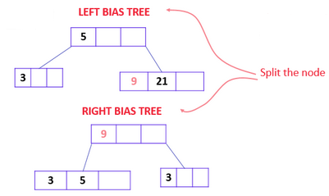
Insertion in B Tree
9
Order =4
List=5,3,21,9,1,13,2,7
Min no of nodes(non-root)=(n-1)/2=3/2=1
Insert 9
Even number of keys,
The middle node will be selected by
Left bias or
Right bias
3 | 5 | 21

Slide 40
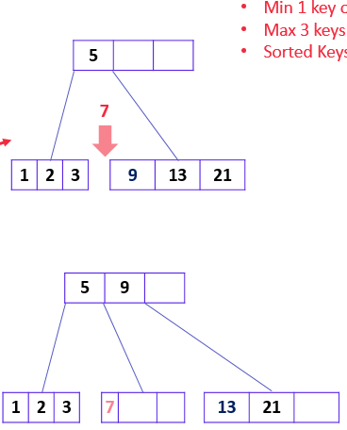
Insertion in B Tree
Order =4
List=5,3,21,9,1,13,2,7
Middle key by Left bias

Slide 41
Splitting in B Tree
List=10, 20, 30, 40, 50, 60, 70, 80 and 90
Insert in an initially empty B-Tree of Order 6
n=6
Max no of keys in each node (root/non-root)=n-1=5
Min no of keys in each non-root node=(n-1)/2
=(6-1)/2
=5/2
=2

Slide 42


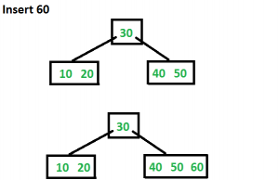
Splitting in B Tree
List=10, 20, 30, 40, 50, 60, 70, 80 and 90
Insert 10
Insert 20,30,40
Insert 60
Since root node is full,
Node will split into two nodes
Median=30, using Left Bias so 30 goes to parent or becomes root,
60

Slide 43
Splitting in B Tree
Construct a B-Tree with data 75,52,81,40,33,90,85,20,38
Insert in an initially empty B-Tree of Order 4
n=4
Max no of keys in each node (root/non-root)=n-1=3
Min no of keys in each non-root node=(n-1)/2=(3)/2=1

Slide 44
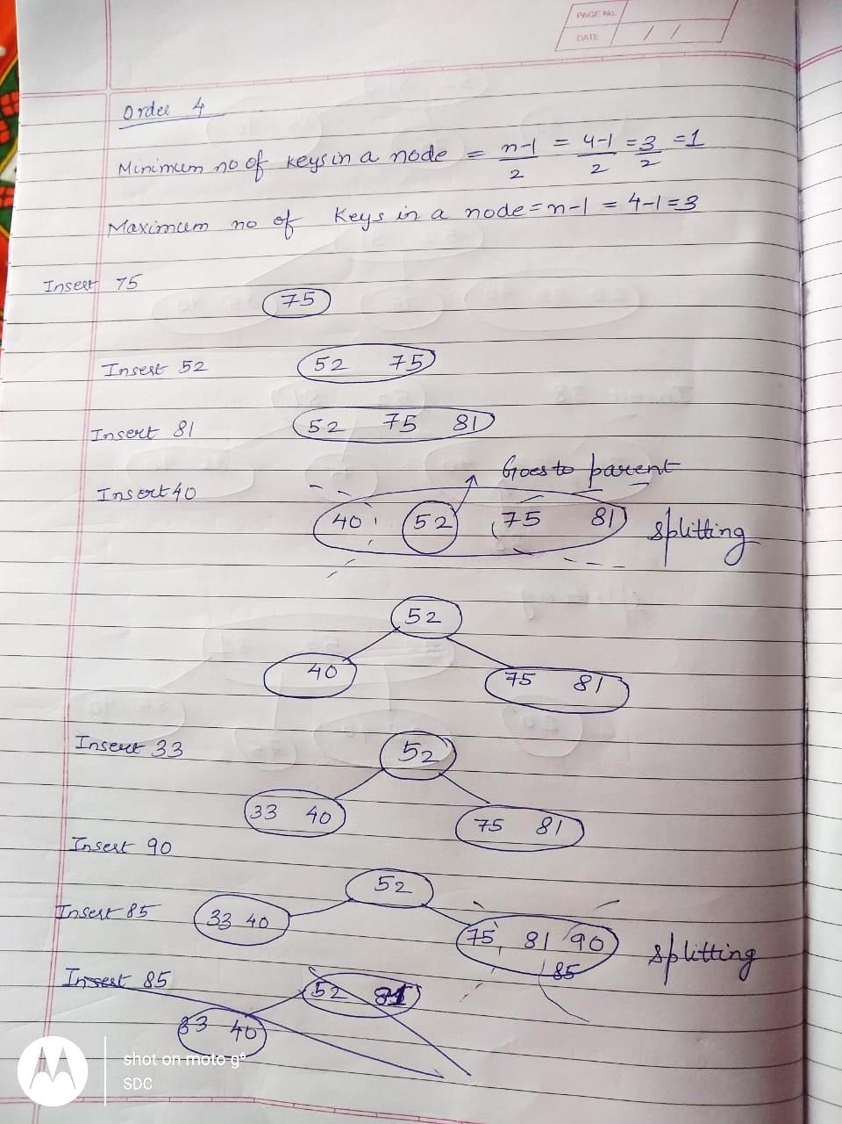

Slide 45
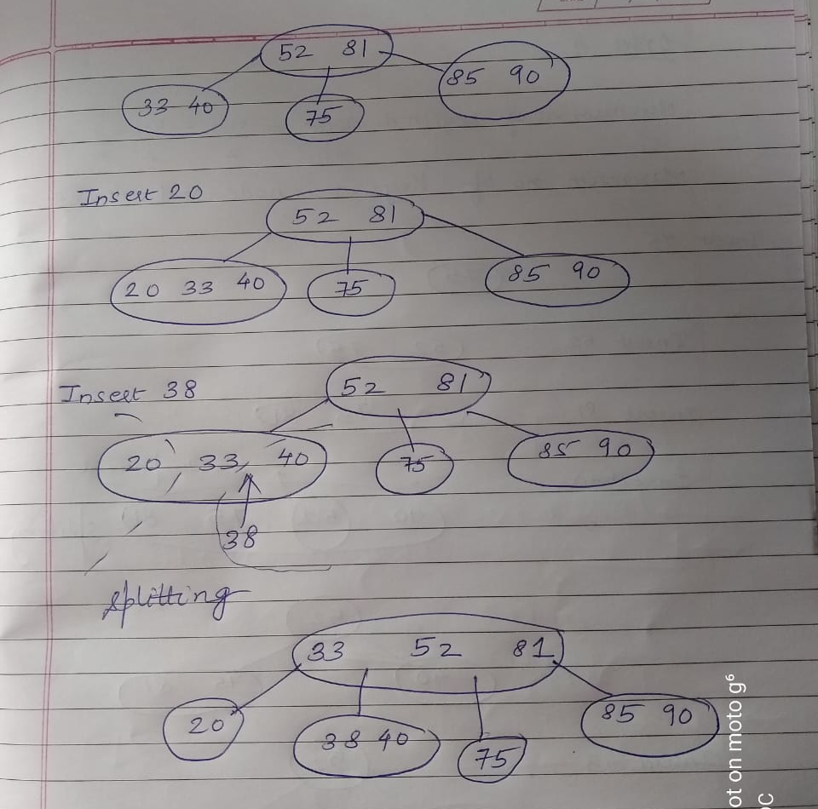

Slide 46
Deletion in B Tree

Slide 47
Deletion in B Tree
Deletion also requires traversal
After reaching a particular node
2 cases may occur-
Node is a leaf node
Node is non leaf node

Slide 48
Deletion in B Tree
Case 1-Node is a leaf node
If node has more than minimum of keys then it can be easily deleted
Just delete it
Deleting this will not violate the property of B Tree

Slide 49
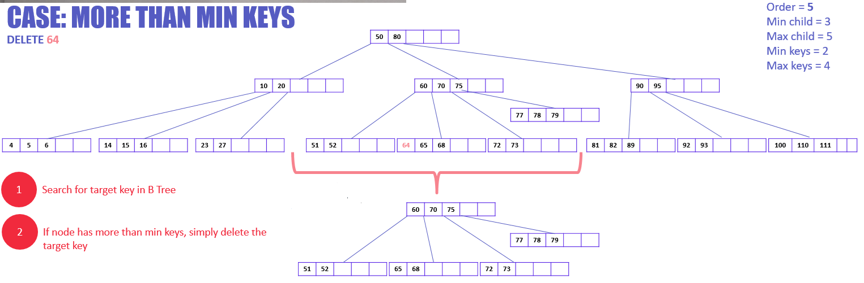
Deletion in B Tree
Case 1-Node is a leaf node

Slide 50
Deletion in B Tree
Case 1-Node is a leaf node
If it has minimum no of keys
Deleting this will violate the property of B Tree
Target node can borrow key from immediate left node, or immediate right node (sibling)
The sibling will say yes if it has more than minimum number of keys
The key will be borrowed from the parent node, the max value of sibling will be transferred to a parent [Left Sibling]
The max value of the parent node will be transferred to the target node, and remove the target value

Slide 51
Deletion in B Tree
Case 1-Node is a leaf node
If it has minimum no of keys
Pull up one key from adjacent node to father and pull down the father

Slide 52
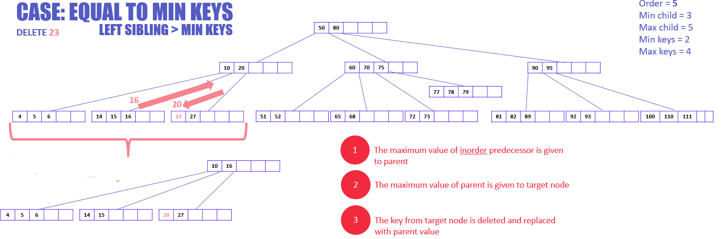
Deletion in B Tree
Case 1-Node is a leaf node

Slide 53
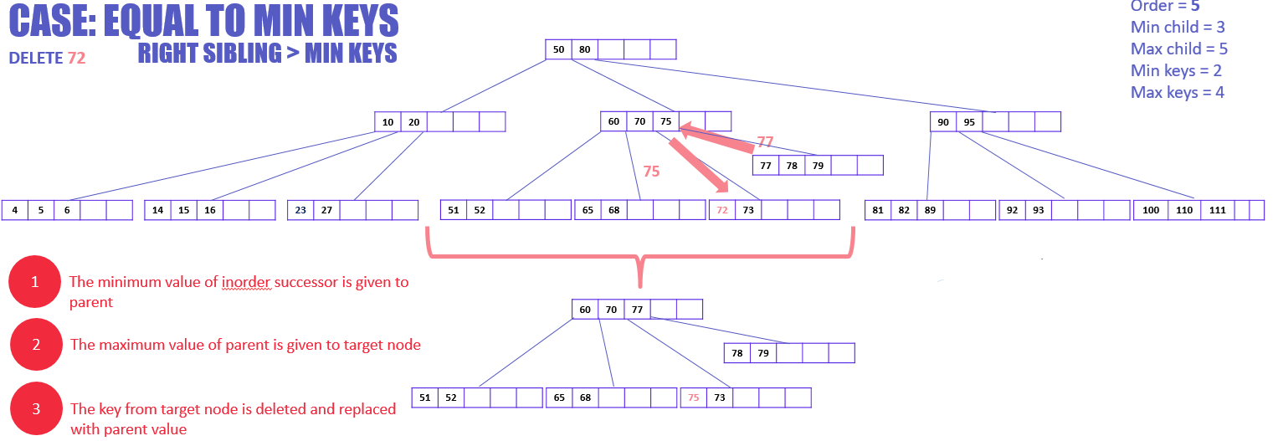
Deletion in B Tree
Case 1-Node is a leaf node

Slide 54
Deletion in B Tree
Case 1-Node is a leaf node
If it has minimum no of keys
Key cannot be borrowed from Sibling
Merge the target node with any of its immediate siblings along with parent key
That key from the parent node is merged which comes in between the two merging sibling
Delete the target key from the merged node

Slide 55
Deletion in B Tree
Case 1-Node is a leaf node
If it has minimum no of keys
If adjacent node also has minimum no of keys, then the two adjacent leaves and the median key from the parent can be combined as one new leaf

Slide 56
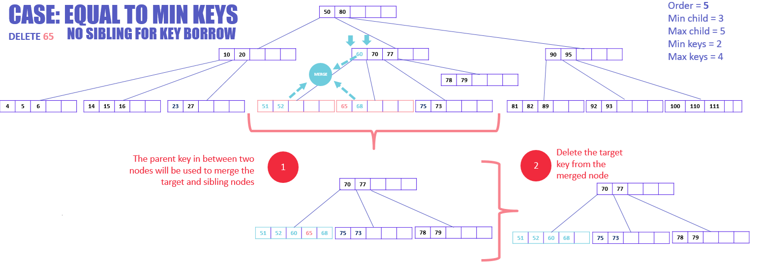
Deletion in B Tree
Case 1-Node is a leaf node
If it has minimum no of keys
Key cannot be borrowed from Sibling

Slide 57
Deletion in B Tree
Case 2-Node is a non leaf node
The key will be deleted and its predecessor or successor key will come on its place
(Inorder Predecessor or Inorder Successor, depending on which child node has extra keys)
If suppose both nodes of predecessor and successor have minimum keys then the nodes of predecessor and successor will be combined

Slide 58
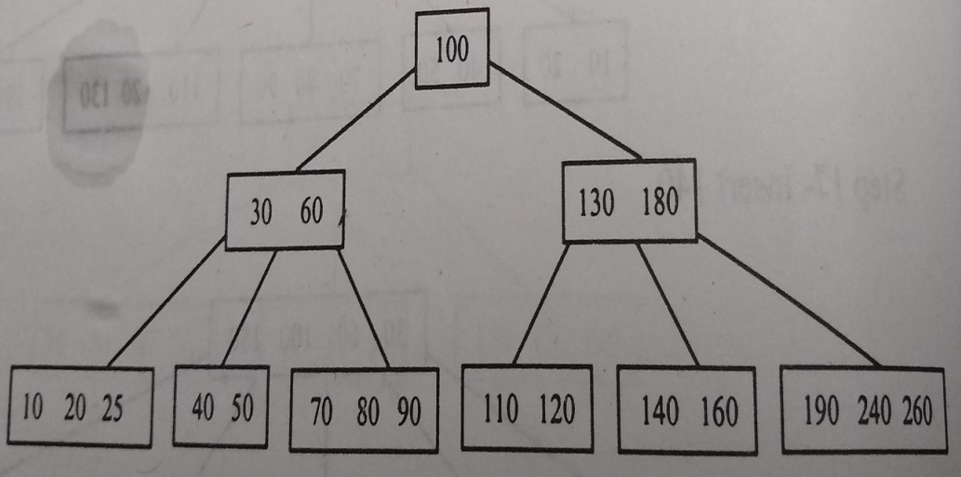
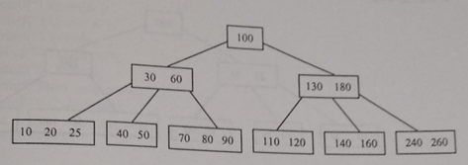
Deletion in B Tree
Delete 190
Case 1-Node is a leaf node
If node has more than minimum of keys
Just delete it

Slide 59
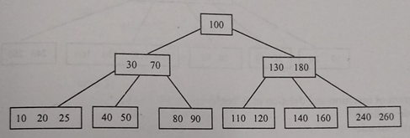
Deletion in B Tree
Delete 60
Case 2-Node is a non leaf node
The key will be deleted and its predecessor or successor key will come on its place

Slide 60
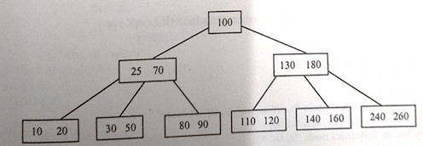
Deletion in B Tree
Delete 40
If it has minimum no of keys
Pull up one key from adjacent node to father and pull down the father

Slide 61
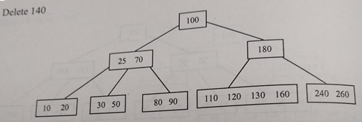
Deletion in B Tree
Delete 140
Case 1-Node is a leaf node
If it has minimum no of keys
If adjacent node also has minimum no of keys, then the leaves and the median key from the parent can be combined as one new leaf

Slide 62
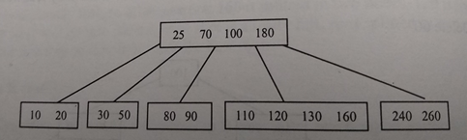
Deletion in B Tree
Merging at Level 0
Final Tree

Slide 63
Uses/Application of B Tree

Slide 64
Use of B Tree
B-trees are balanced search trees designed to work well on magnetic disks or other direct-access secondary storage devices
Better at minimizing disk I/O operations
There is huge amount of data that cannot fit in main memory.
When the number of keys is high, the data is read from disk in the form of blocks.
Disk access time is very high compared to the main memory access time.

Slide 65
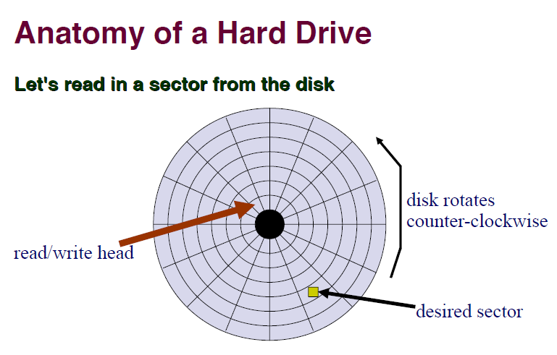

Slide 66
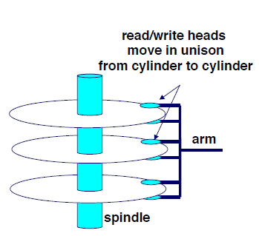
Use of B Tree
The time it takes to access data on secondary storage is a function of three variables:
The time it takes for the arm to move to the track where the requested sector lies. Usually around 10 milliseconds.
The time it takes for the right sector to spin under the arm. For a 7200 RPM drive, this is 4.1 milliseconds.
The time it takes to read or write the data. Depending on the density of the data, this time is negligible compared to the other two.

Slide 67
Use of B Tree
Data can be arranged into "blocks" that are these adjacent multi-sector aggregates.
Contrast this to access times to RAM.
A typical non-sequential RAM access took about 5 microseconds.
This is 3000 times faster; we can do at least 3000 memory accesses in the time it takes to do one disk access,

Slide 68
Use of B Tree
One of the main reason of using B tree is
its capability to store large number of keys in a single node and
by keeping the height of the tree relatively small.
The main idea of using B-Trees is to reduce the number of disk accesses.

Slide 69
Use of B Tree
Most of the tree operations (search, insert, delete, max, min, ..etc ) require O(h) disk accesses
where h is the height of the tree.
The height of B-Trees is kept low by putting maximum possible keys in a B-Tree node.
Generally, the B-Tree node size is kept equal to the disk block size.

Slide 70
Use of B Tree
In a typical B-tree application, the amount of data handled is so large that all the data do not fit into main memory at once.
The B-tree algorithms copy selected blocks from disk into main memory as needed and write back onto disk pages that have changed.
Since the B-tree algorithms only need a constant number of blocks in main memory at any time, the size of main memory does not limit the size of B-trees that can be handled.

Slide 71
Use of B Tree
Pseudocode for disk operations-
. . .
x a pointer to some object
DISK-READ(x)
operations that access and/or modify the fields of x
DISK-WRITE(x) Omitted if no fields of x were changed.
other operations that access but do not modify fields of x
...

Slide 72
Use of B Tree
B-trees are balanced trees that are optimized for situations
when part or all of the tree must be maintained in secondary storage such as a magnetic disk.
Since disk accesses are expensive (time consuming) operations, a b-tree tries to minimize the number of disk accesses.

Slide 73
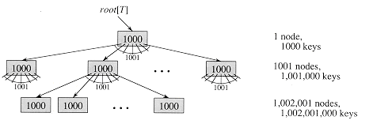
Use of B Tree
A B-tree of height 2 containing over one billion keys.
Each internal node and leaf contains 1000 keys.
There are 1001 nodes at depth 1 and over one million leaves at depth 2.

Slide 74
Use of B Tree
A b-tree with a height of 2 and a branching factor of 1001 can store over one billion keys
But requires at most two disk accesses to search for any node .

